Slide 1
Early Career Transition for Women in Nephrology
Silvi Shah, MD, MS, FASN, FACP
University of Cincinnati
@silvishah

Slide 2
Disclosures
Member, Media and Communications Committee, American Society of Nephrology
Executive Council, Women in Nephrology
Executive Committee Member, Young faculty Community of Practice, American Society of Transplantation
Member, NSMC and NephJC
@silvishah

Slide 3
Objectives
Preparing for job interview
Contract negotiation
Building your clinical portfolio
@silvishah

Slide 4
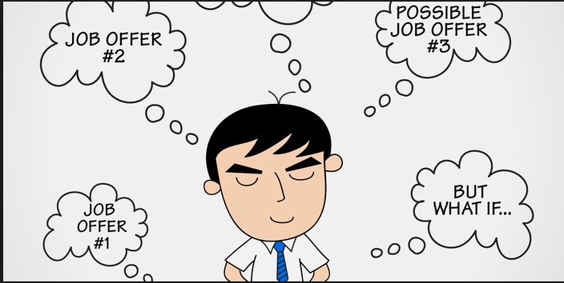
@silvishah

Slide 5
Job Specifics
Faculty interview – what is it?
Promote yourself
Communication
Use the opportunity to your benefit – network and collaborate
@silvishah
Notes:
Usually two day interviews. 360 degree evaluation. Cover letter.
Promote yourself- team player and clinical acumen as team strengths. Show what you can do. Don’t focus on the perceived weaknesses
Communication- direct communication. Indirect communication – firm handshake.
Network and collaboarte. Paid interviews. Explore the opportunity.

Slide 6
Things to Consider
Leadership
Retention of faculty
Benefits – retirement plans, health insurance, tuition remission, relocation, vacation, tail coverage
Mentorship and sponsorship
Timeline of contract/non-competes
@silvishah

Slide 7
@silvishah

Slide 8
Negotiate! Negotiate! Negotiate!
Clinical time - inpatient weeks, clinics, and dialysis rounding; should be in the contract
Compensations model - collections, RVU’s, or productivity
Start-up package for junior faculty
Protected time
@silvishah
Notes:
Win win situation for both- if you don’t ask you will not get

Slide 9
Always Negotiate Your Salary
AAMC nationwide median salary
Ask your peers
Discuss with business administrator and chair
Discuss compensation of administrative work, education, and research activities
Reevaluate every few years
@silvishah

Slide 10
Never Negotiate in your emotional basement

Slide 11
Building Your Portfolio
What is your area of excellence?
What ties your activities together? Discern a “theme” among your teaching, research, service, and patient care
How can you and your activities align with those of your department?
@silvishah
Notes:
It may be an activity?
A subject (patient care)?

Slide 12
@silvishah

Slide 13
Career Goals
Develop a written action plan
2-5 year vision
Goals
Annual check-up
Performance review
Have a trusted person review and guide
Notes:
Annual check- performance review

Slide 14
Manage your Career
Identify resources and opportunities - be proactive!
Update job description and effort allocation
Advocate for yourself
Network and collaborate
Review institution criteria for promotion. What activities count? Talk with recently promoted faculty.
Review your CV with your department chair, member of promotion and tenure committee
@silvishah

Slide 15
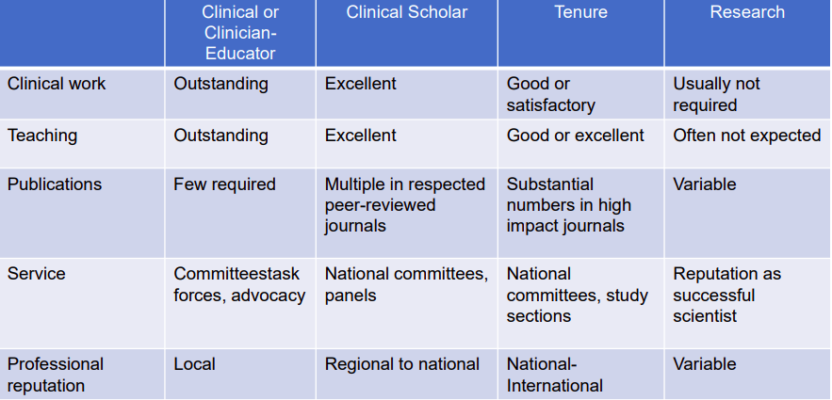
Promotion Criteria – Assistant to Associate
@silvishah

Slide 16
Self-Promote
Communicate your achievements to leadership
Prepare your 2-minute elevator speech
Use institute media office
Use social media
@silvishah
Notes:
Self promotion and self branding

Slide 17
Thank You
@silvishah

